Slide 1
Social Analytics Command Center

Slide 2
Abstract
The Social Media Command Center is a complex program designed to monitor and analyze user activity on various social media platforms.
The innovative tool includes sentiment analysis to measure user sentiment and sentiment. One of its main features is the ability to disable unwanted features, allowing you to access content and communications.
The system uses sentiment analysis to identify and correct harmful or counterproductive user behavior to create a better and more manageable online environment.
This allows the system to distinguish between positive, negative, and neutral emotions.

Slide 3
User module

Slide 4

Home page

Slide 5
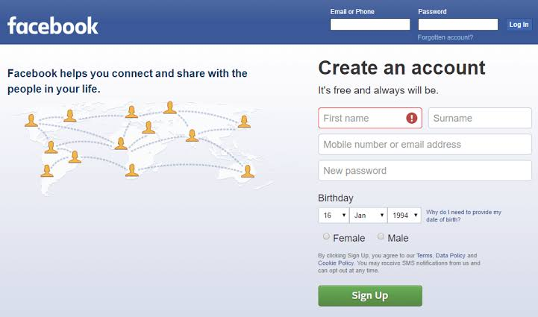
User register page

Slide 6
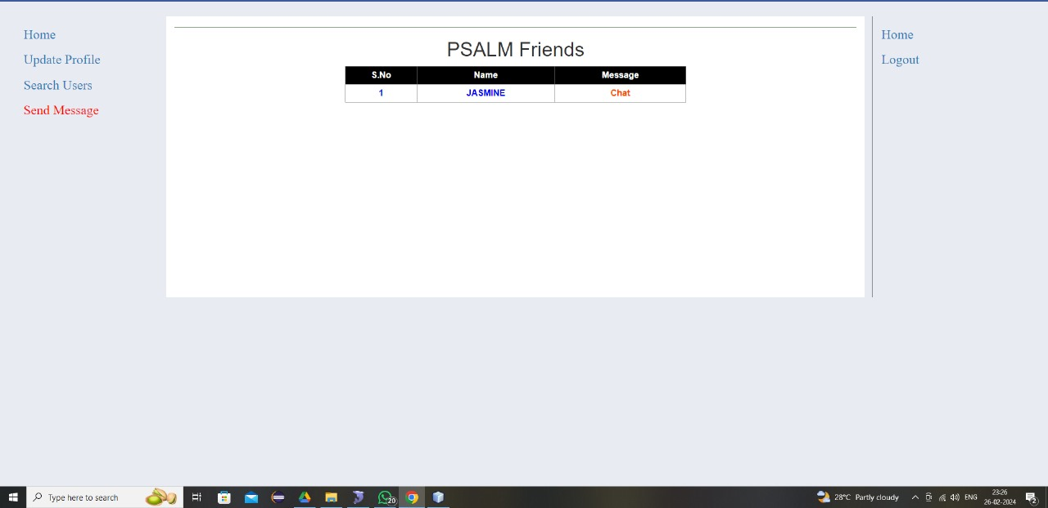
Chat window

Slide 7
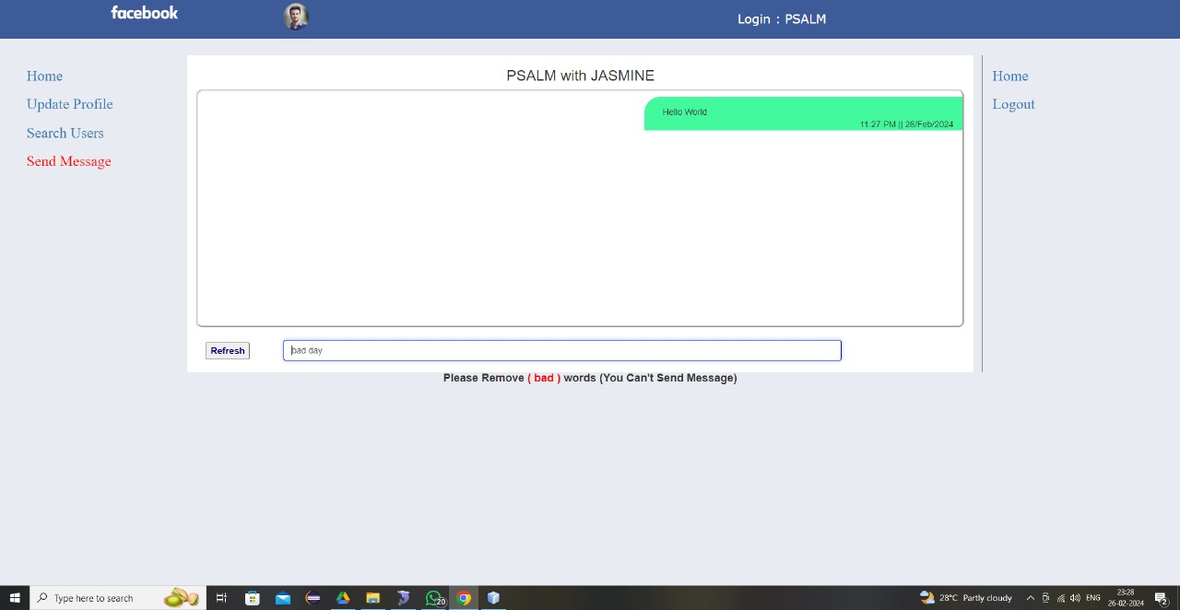
Detect unwanted words

Slide 8
Admin module

Slide 9
Home page

Slide 10
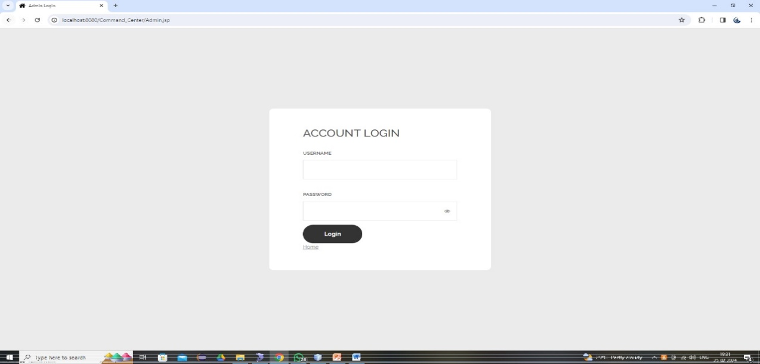
Admin login page

Slide 11

Admin home page

Slide 12
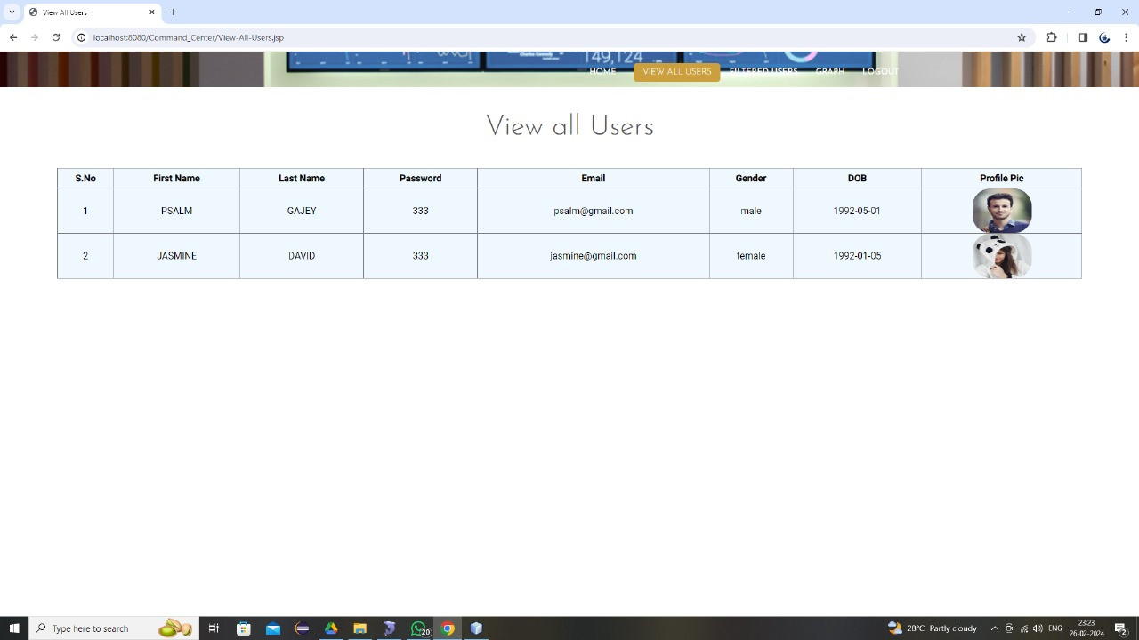
View all users

Slide 13
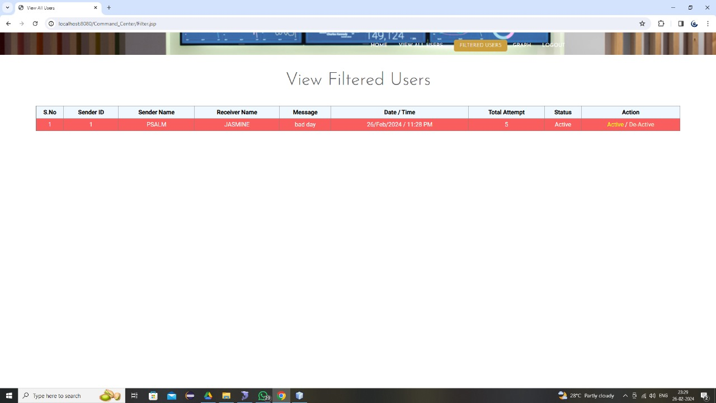
View filtered user

Slide 14
Thanking you

